Slide 1

UE23CS320B – Capstone Project Phase – 2
Project Progress Review #1
Project Title : Toward Trustworthy Stock Prediction : A Self-Aware Multimodal Quant AI Framework
Project ID : PW26_MG_02
Project Guide : Prof. Mahitha G
Project Team :
ADISHREE GUPTA | PES1UG23CS024
AKSHAT | PES1UG23CS048
BHAVANI S | PES1UG23CS144
BHUMIKA S LOKARE | PES1UG24CS803
Adishree Gupta_Bhumika Lokare_Bhavani S_Akshat

Slide 2
Toward Trustworthy Stock Prediction : A Self-Aware Multimodal Quant AI Framework
Outline
Abstract and scope.
Suggestions from phase-1
Literature survey
Design Approach
Design constraints, Assumptions and Dependencies
Proposed methodology/Approach
Architecture
Project Progress Plan for Phase 2
References
Any other Information
Adishree Gupta_Bhumika Lokare_Bhavani S_Akshat

Slide 3
Toward Trustworthy Stock Prediction : A Self-Aware Multimodal Quant AI Framework
Problem Statement
Building Trustworthy Stock Prediction: From Problem to Self-Aware AI Solution
“Traditional quantitative models and modern AI for Financial Securities prediction are often rigid, opaque, and unaccountable. This project addresses these limitations by developing a self-aware, multimodal AI framework that dynamically adapts to real-time markets, provides explainable predictions, and ensures verifiable accountability through transparent data logging.”
The Opportunity: Develop a trustworthy, explainable prediction platform that addresses these critical pain points.
Adishree Gupta_Bhumika Lokare_Bhavani S_Akshat

Slide 4
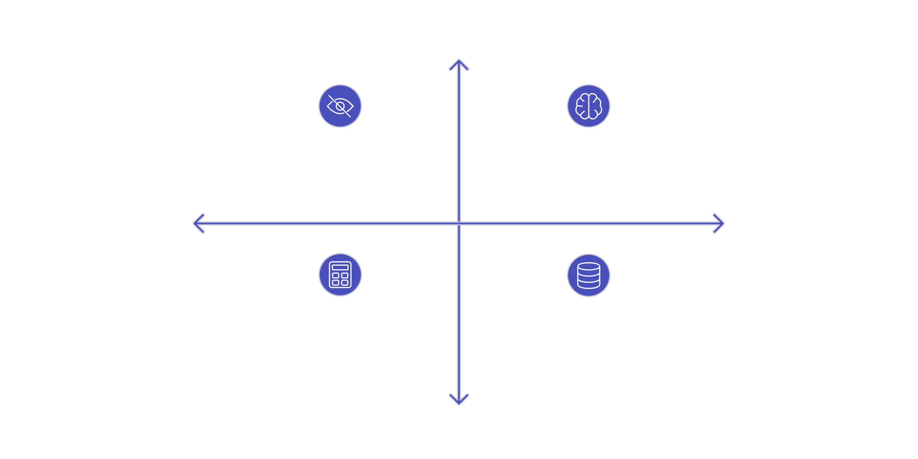




Toward Trustworthy Stock Prediction : A Self-Aware Multimodal Quant AI Framework
Abstract and Scope
Abstract
This work introduces a principled analytical framework for trustworthy stock prediction,
addressing the growing need for adaptive, explainable, and auditable AI systems
in increasingly volatile and regulated financial markets.
High Market Growth
Scope
Opaque AI models
Adaptive, explainable,
audit-grade AI
Persistent market volatility
Regulatory demand for explainability and audit trails
Investor distrust of opaque AI and data sources
Low
Competitive Advantage
High
Competitive Advantage
Traditional quantitative models
Opaque legacy data providers
→ Drives competitive reallocation
Low Market Growth
Analytical focus: Evaluation of long-term value creation potential in financial modeling systems combining adaptability, explainability, and regulatory-grade accountability.
Adishree Gupta_Bhumika Lokare_Bhavani S_Akshat

Slide 5
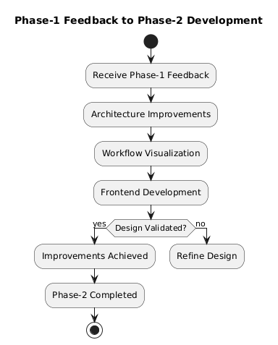

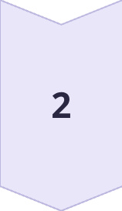
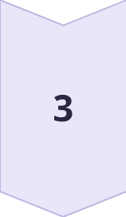
Toward Trustworthy Stock Prediction : A Self-Aware Multimodal Quant AI Framework
Suggestions from Phase1
Feedback Received
Enhance architectural clarity
Demonstrate implementation feasibility
Improve module separation
Actions Implemented
User interface designed to reflect real-world trading systems
Core user workflows visualized through UML diagrams
Frontend prototype developed to validate system feasibility
Improvements Achieved
Clear component boundaries
Enhanced visualization of market data using interactive charts and indicators
Better alignment of system design with real-world trading platforms
Adishree Gupta_Bhumika Lokare_Bhavani S_Akshat

Slide 6
Toward Trustworthy Stock Prediction : A Self-Aware Multimodal Quant AI Framework
Literature Survey
Paper Details | Aim of the paper ( In One Line) | Method | Limitations of the paper | Relation to Project Hypothesis
FinRL: Adaptive Model Selection for Reinforcement Learning in Stock Trading Link: https://ieeexplore.ieee.org/document/11038809 Year 2025 | Create market-adaptive trading system selecting models based on bull/bear market trends. | FinRL-DeepSeek using dynamic RL agents and LLM sentiment for market-specific trading | High computational costs, latency in switching, and dependency on real-time news data. | Supports — Demonstrates adaptive model selection aligned with dynamic, explainable decision systems
A Novel RMS-Driven Deep Reinforcement Learning for Optimized Portfolio Management in Stock Trading Link: https://ieeexplore.ieee.org/document/10904473 Year 2025 | Optimize portfolio management using multi-source signals and risk-aware reward functions | A2C, DDPG, and PPO agents using historical data, technical indicators, and sentiment. | Limited market testing, lacks real-time validation, and relies on daily data. | Supports — Shows adaptability and risk-awareness but limited explainability
Magic Net: Memory-Aware Graph Interactive Causal Network for Multivariate Stock Price Movement Prediction Link: https://ieeexplore.ieee.org/document/10834555 +A5Year 2025 | Predict multivariate movements using causal correlations and temporal text memory. | Graph interactive causal network incorporating text memory and hierarchical dependencies | High computational complexity and scalability issues with large numbers of stocks. | Strongly Supports — Introduces causal reasoning and interpretability beyond black-box prediction
Stock Market Analysis and Price Prediction Link: https://ieeexplore.ieee.org/document/11031782 Year 2025 | Enhance forecasting accuracy by integrating fundamental, technical, and deep learning methods. | Hybrid framework combining Logistic Regression, KNN, and LSTM for layered predictions | High training complexity and significant dependency on data quality and tuning. | Alternative Hypothesis — Focuses on accuracy-driven hybrid models with limited explainability
Portfolio Research Based on LSTM Model Link: https://ieeexplore.ieee.org/document/11075488 Year 2025 | Predict CSI 300 prices and construct portfolios using LSTM neural networks. | LSTM neural network trained on historical price data for top index constituents. | Restricted scope to top 10 stocks and lacks external sentiment factors. | Alternative Hypothesis — Emphasizes predictive performance over transparency and uncertainty handling
Overall, the literature indicates that while accuracy-driven and hybrid prediction models perform well under stable conditions, adaptive and explainability-first approaches provide stronger robustness, trust, and decision reliability in volatile market environments, which directly motivates the proposed system.
Adishree Gupta_Bhumika Lokare_Bhavani S_Akshat

Slide 7

Toward Trustworthy Stock Prediction : A Self-Aware Multimodal Quant AI Framework
Challenges and Research Gaps
Dataset & Data Provenance Gaps
Prediction Reliability & Context Gaps
Real-Time Adaptability & Explainability Gaps
Accountability & Auditability Gaps
Heavy reliance on aggregated, weakly labeled, or unverified datasets
Limited guarantees on data quality, freshness, and source provenance
Poor alignment between training data and real-time market conditions
No tamper-proof logging of data, parameters, and decisions
Missing traceability across prediction lifecycles
Insufficient regulatory and manipulation safeguards
Predictions exposed without uncertainty or confidence bounds
Weak contextual justification beyond raw output values
Failure to abstain under low-confidence or out-of-distribution inputs
Static or coarse regime assumptions (e.g., bull/bear phases)
Inadequate recalibration to live market signals
Black-box deep models lack interpretable, auditable reasoning
These limitations undermine prediction reliability, trust, and safe real-world deployment.
Adishree Gupta_Bhumika Lokare_Bhavani S_Akshat

Slide 8
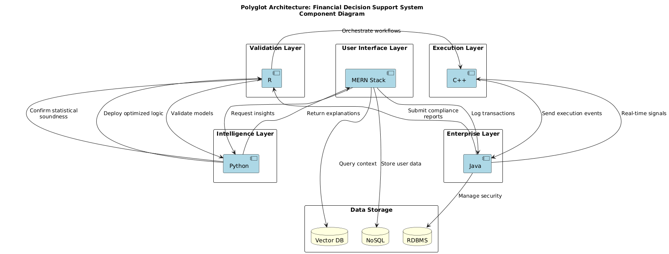
Toward Trustworthy Stock Prediction : A Self-Aware Multimodal Quant AI Framework
Design Approach
Adishree Gupta_Bhumika Lokare_Bhavani S_Akshat

Slide 9
Toward Trustworthy Stock Prediction : A Self-Aware Multimodal Quant AI Framework
Design Approach
Design Approach Followed
We followed a frontend-first, modular polyglot design approach.
The system is designed as logically independent components
Each component is planned to use the most suitable technology for its role
User interaction and visualization are prioritized in the current phase
UML diagrams are used to formally capture system structure and flow
The approach emphasizes clear separation of concerns rather than early integration.
Why this approach was chosen
Financial decision systems involve diverse responsibilities such as visualization, analytics, and explanation
A single monolithic design limits flexibility and clarity
A frontend-first approach helps validate feasibility early
Modular design reduces coupling and improves understandability
Polyglot architecture allows future scalability without redesign
Benefits
Clear component boundaries improve architectural clarity
Easier understanding and validation of system flow
Technology flexibility for different system responsibilities
Independent development and testing of modules
Better alignment with real-world financial platforms
Drawbacks
Higher architectural complexity compared to monolithic designs
Requires careful definition of interfaces between components
Integration effort is deferred to later phases
These drawbacks are acceptable at this stage since the focus is on design validation and feasibility.
Adishree Gupta_Bhumika Lokare_Bhavani S_Akshat

Slide 10
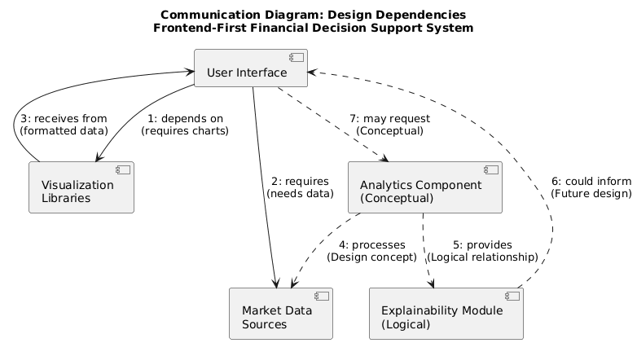
Toward Trustworthy Stock Prediction : A Self-Aware Multimodal Quant AI Framework
Design Constraints, Assumptions & Dependencies
Design Constraints
• Academic time constraints limited full end-to-end integration
• No access to live trading or real-money execution environments
• System required to remain explainability-focused rather than accuracy-focused
• Design needed to support multiple technologies without tight coupling
Design Dependencies
• Availability of historical market data for visualization
• Visualization and charting libraries for frontend rendering
• Well-defined interfaces between logical system components
• UML modeling tools for design validation
Impact on the Project
• Enables early validation of user workflows
• Reduces risk of architectural rework in later phases
• Allows independent evolution of system components
• Shifts integration effort to subsequent phases
Design Assumptions
• Users benefit more from transparent visual explanations than raw predictions
• Historical market data is sufficient for demonstrating feasibility
• Clear separation of system components improves understandability
• Integration can be safely deferred if system flow is well-defined
Adishree Gupta_Bhumika Lokare_Bhavani S_Akshat

Slide 11
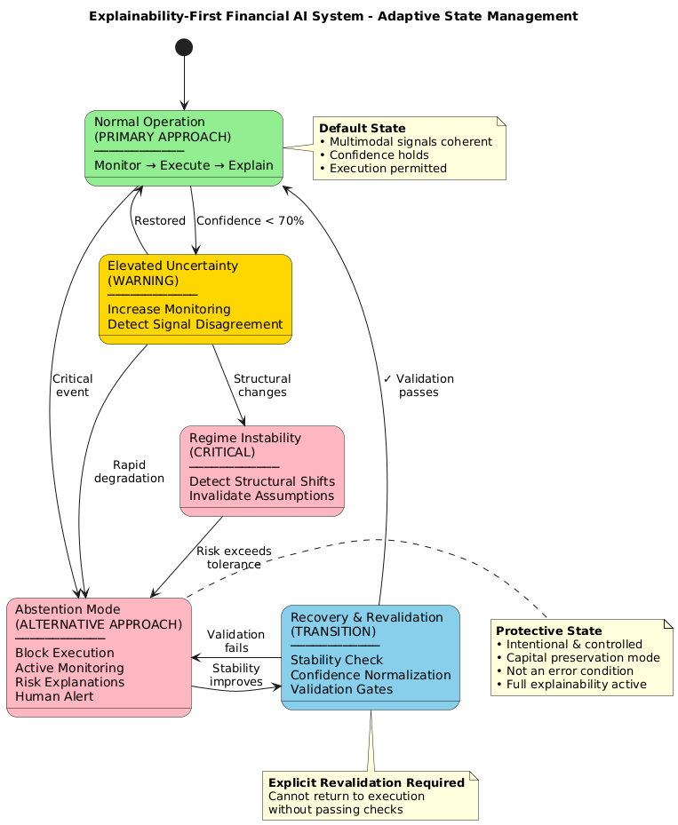
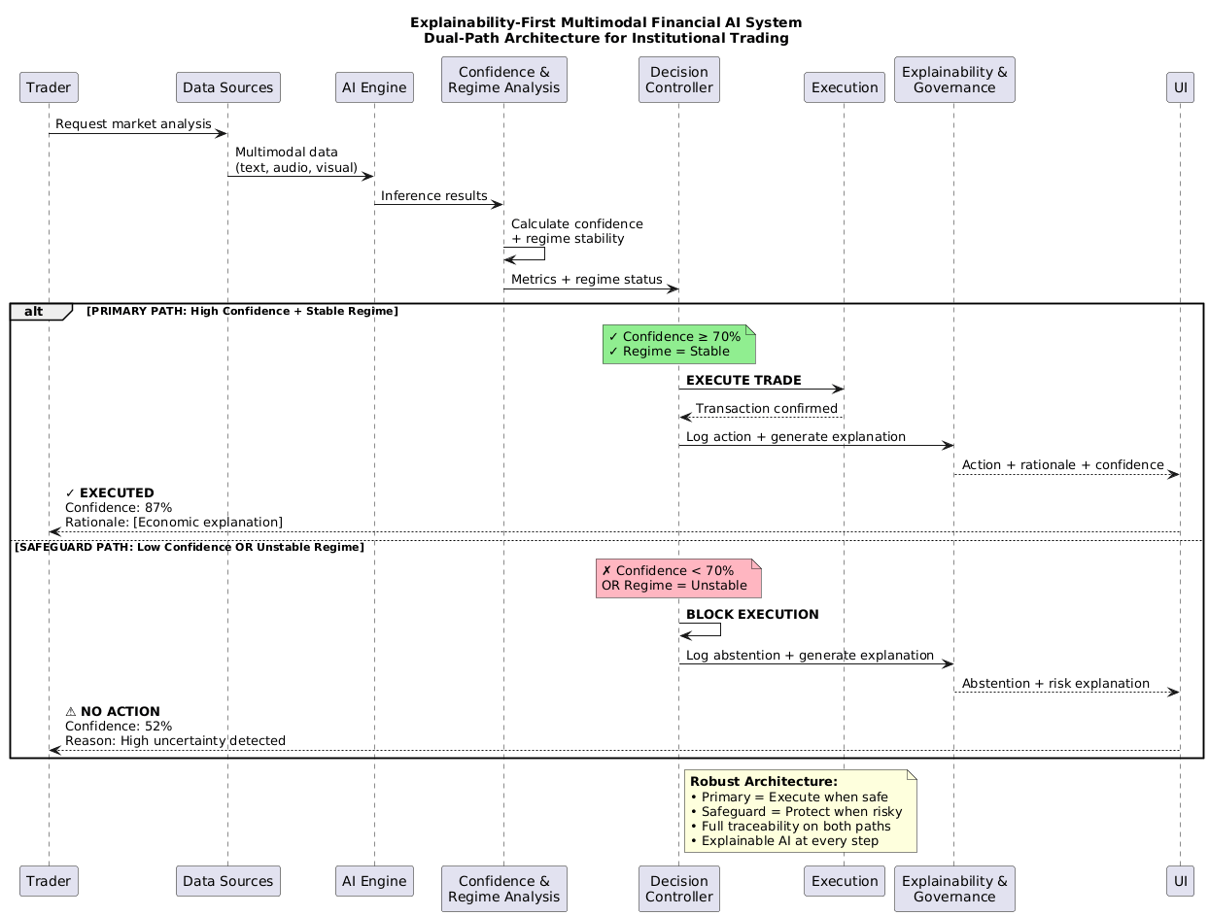
Toward Trustworthy Stock Prediction : A Self-Aware Multimodal Quant AI Framework
Proposed Methodology / Approach
Adishree Gupta_Bhumika Lokare_Bhavani S_Akshat

Slide 12
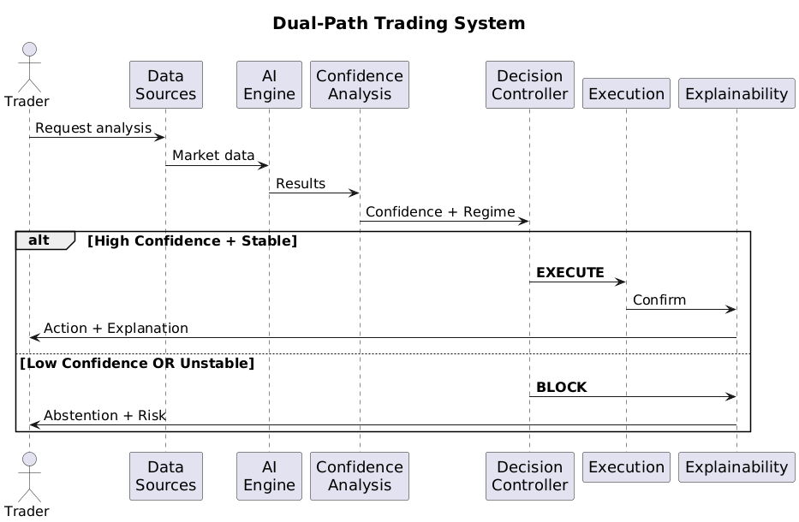
Toward Trustworthy Stock Prediction : A Self-Aware Multimodal Quant AI Framework
Proposed Methodology / Approach
Adishree Gupta_Bhumika Lokare_Bhavani S_Akshat

Slide 13
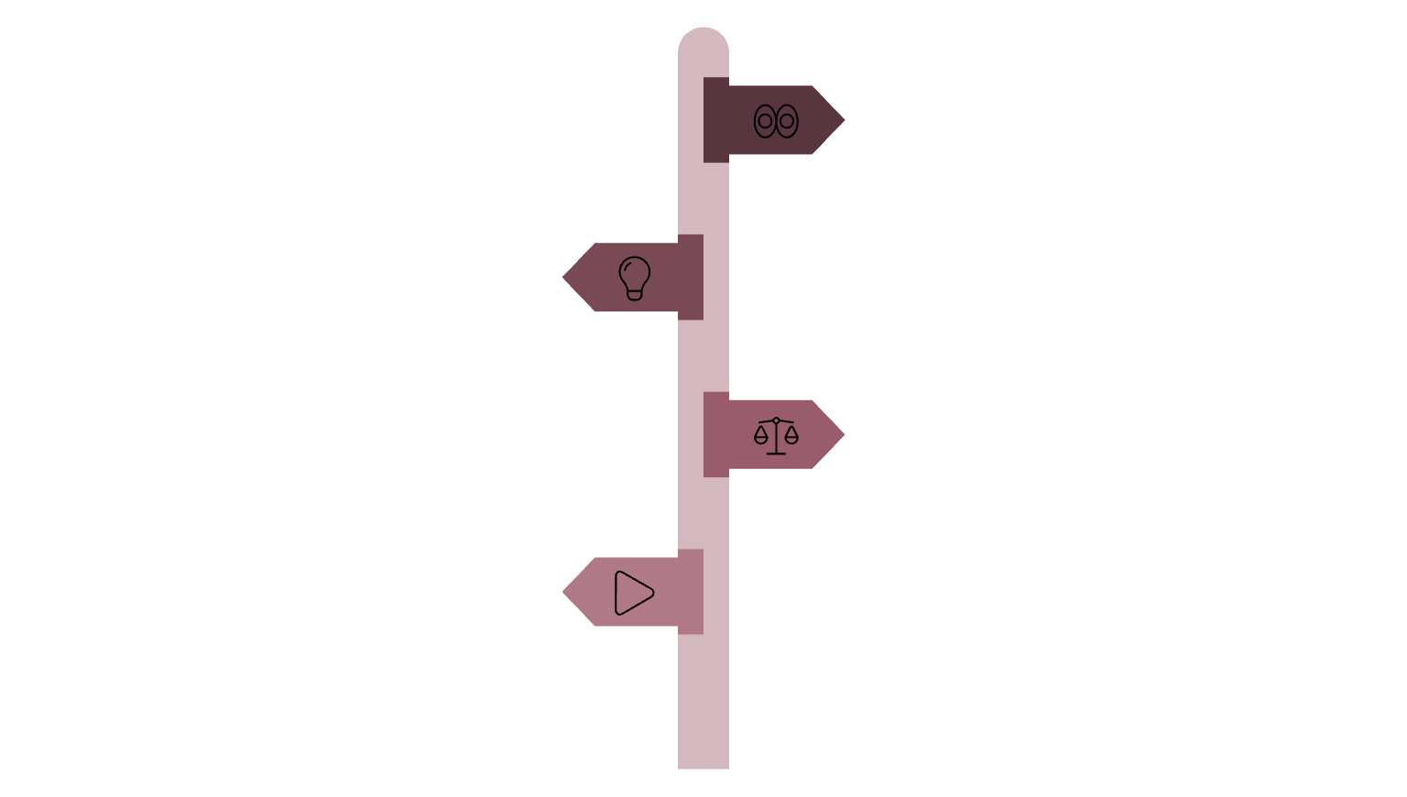




Toward Trustworthy Stock Prediction : A Self-Aware Multimodal Quant AI Framework
Proposed Methodology / Approach
Core Philosophy: Execute decisions under high confidence with transparent justifications; abstain under uncertainty to preserve system integrity.
Explainability gates every action, ensuring continuous monitoring, gradual state transitions, and safe operational boundaries in dynamic environments.
System Dynamics
Two operational states: Stable (full execution) and Protective (monitored abstention)
Gradual regime transitions through warning thresholds prevent abrupt failures
Execution pauses under uncertainty, enabling recovery without termination
Continuous state monitoring maintains system awareness across regimes
Monitor
Continuous observation of inputs and model outputs.
Explain
Governance & Trust
Interpretability layer acts as execution gate.
Explainability requirements enforced during all execution phases
Justification protocols activate during abstention events
Human-in-the-loop escalation for critical uncertainty thresholds
Audit trails and interpretability ensure regulatory compliance
Decide
Confidence assessment determines branch.
Design Intent
Execute
Prioritize explainability-led control mechanisms where transparency drives decision authority. Abstention functions as an active safety fallback, not failure—preserving trust in high-stakes deployments.
Stable regime when confidence is high.
Design Trade-offs
Conservative behavior under uncertainty increases safety margins but may reduce throughput. Higher architectural complexity enables robust adaptability at the cost of implementation overhead.
Central mechanism: Explainability serves as the execution gate; confidence levels and regime states control system behavior and transition dynamics.
Adishree Gupta_Bhumika Lokare_Bhavani S_Akshat

Slide 14
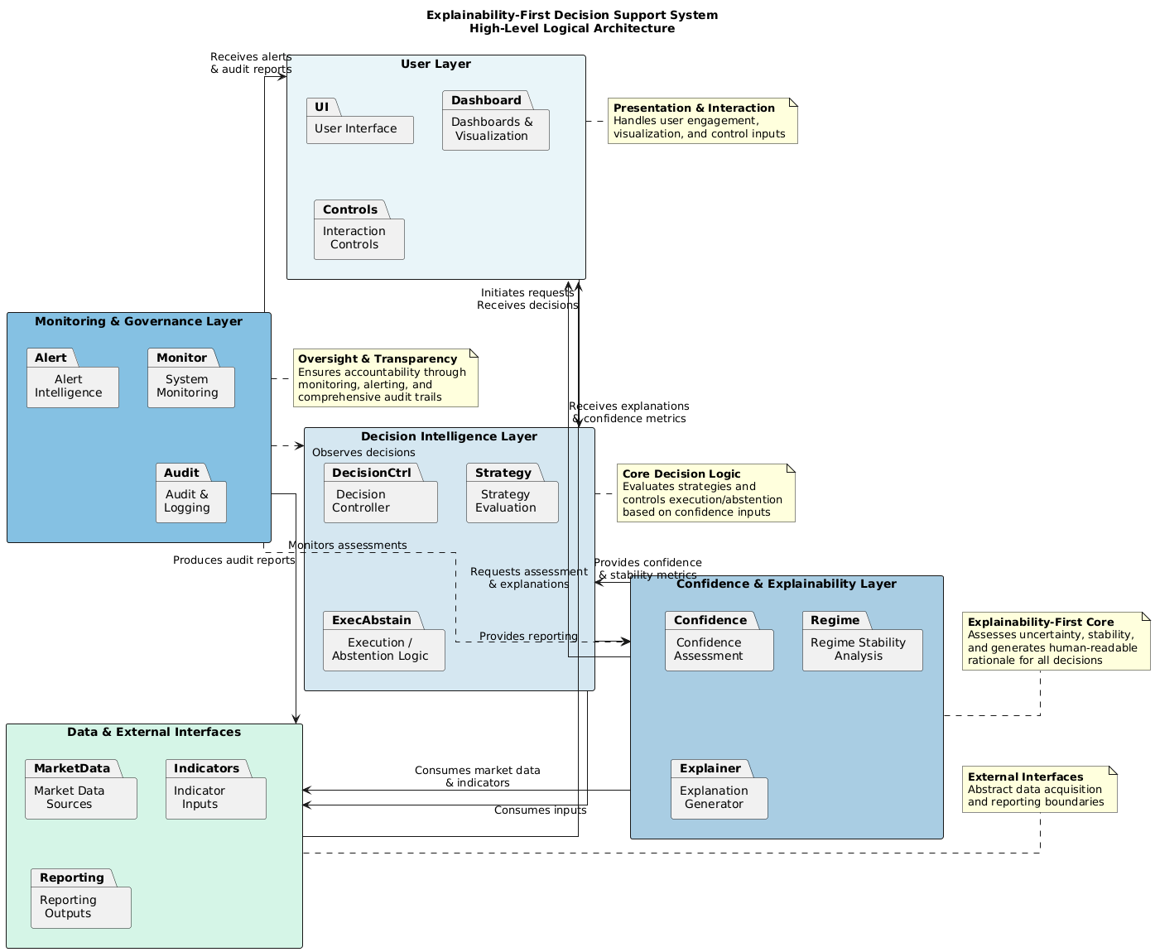
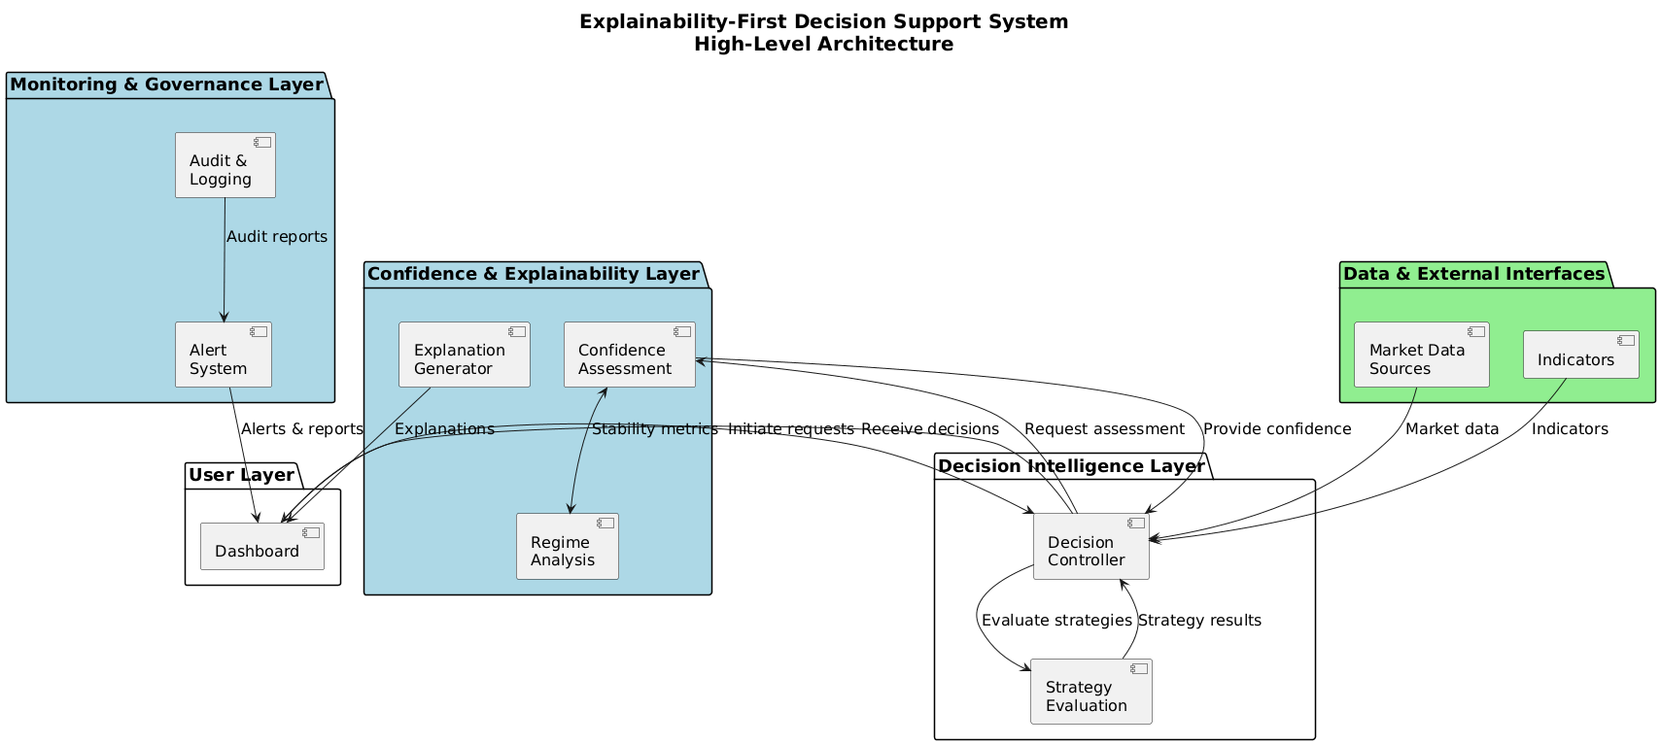
Toward Trustworthy Stock Prediction : A Self-Aware Multimodal Quant AI Framework
Architecture
System Architecture Layers
User Layer: Manages presentation and interaction by handling user engagement through the UI, dashboards for visualization, and interaction controls.
Decision Intelligence Layer: Serves as the core decision logic, evaluating strategies and controlling execution or abstention based on confidence inputs and controller logic.
Confidence & Explainability Layer: Acts as the "Explainability-First Core" by assessing uncertainty and regime stability to generate human-readable rationales for all decisions.
Monitoring & Governance Layer: Provides oversight and transparency through system monitoring, alert intelligence, and comprehensive audit trails to ensure accountability.
Data & External Interfaces Layer: Abstracts data acquisition and reporting boundaries by managing market data sources, indicator inputs, and reporting outputs.
Adishree Gupta_Bhumika Lokare_Bhavani S_Akshat

Slide 15











Toward Trustworthy Stock Prediction : A Self-Aware Multimodal Quant AI Framework
Architecture
Decision Intelligence Layer
Strategy evaluation and decision controller produce prediction candidates—not final actions
Data & External Interfaces
Market data sources, indicators, and signals provide raw, uncertain inputs to the system
Confidence & Explainability Layer
Explainability is the execution gate: Confidence assessment evaluates uncertainty and reliability, regime analysis monitors stability and volatility, explanation generator creates human-readable rationale
Monitoring & Governance Layer
Audit, logging, and alert system ensure full traceability and compliance
User Layer
Dashboard presents decision with confidence scores and explanation—users see both action and reasoning
Adishree Gupta_Bhumika Lokare_Bhavani S_Akshat

Slide 16
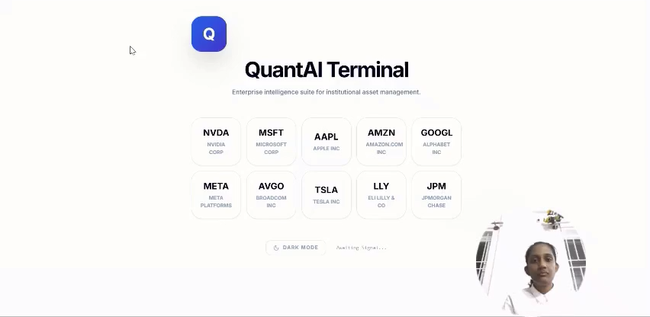
Toward Trustworthy Stock Prediction : A Self-Aware Multimodal Quant AI Framework
Progress Update
Adishree Gupta_Bhumika Lokare_Bhavani S_Akshat

Slide 17

Implementation Challenges & Resource Requirements
Implementation Challenges
Resource Requirements (GPU)
Computational overhead: Multimodal fusion and explainability layers significantly increase training and inference costs
Latency constraints: Real-time confidence estimation and explanation generation introduce measurable delays in prediction pipeline
Regime monitoring complexity: Adaptive market regime detection requires continuous monitoring and dynamic model switching logic
Modular integration: Coordinating data ingestion, feature engineering, prediction, and explanation modules presents architectural challenges
Hardware limitations: Deep learning models infeasible under CPU-only execution within project timeline
Training efficiency: GPU acceleration essential for iterative model development and experimentation cycles
Hyperparameter optimization: Enables systematic tuning across multimodal architectures within academic semester constraints
Near real-time inference: Supports low-latency prediction with integrated explainability components
Scalability testing: Allows evaluation of system performance under varying data volumes and model complexities
Reliability assurance: Facilitates comprehensive testing of confidence calibration and explanation quality metrics

Slide 18
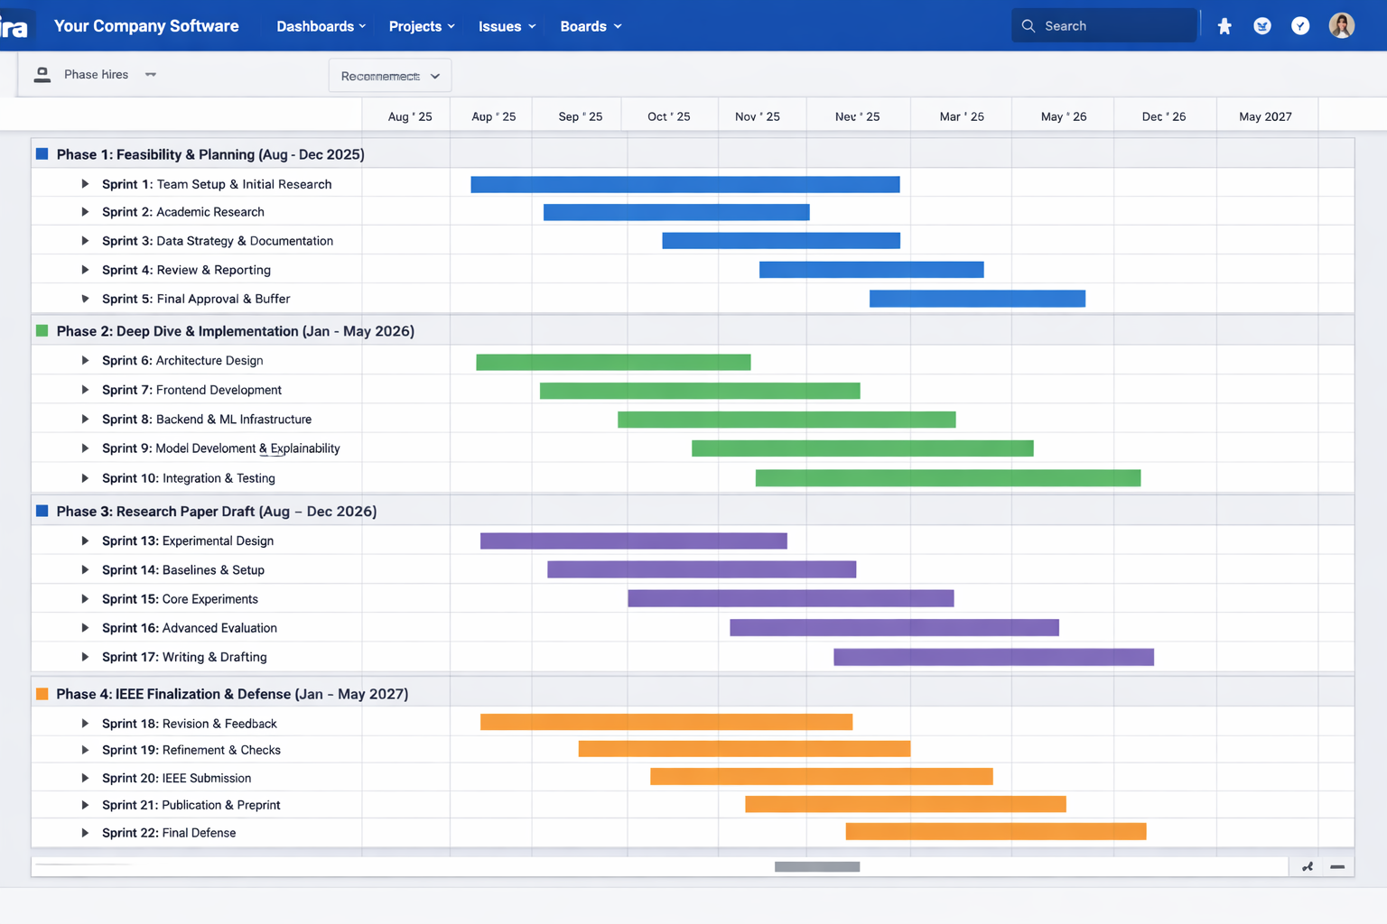
Toward Trustworthy Stock Prediction : A Self-Aware Multimodal Quant AI Framework
Project Progress Plan for Phase 2
Adishree Gupta_Bhumika Lokare_Bhavani S_Akshat

Slide 19
Toward Trustworthy Stock Prediction : A Self-Aware Multimodal Quant AI Framework
References
V. Kosidphokin, P. Loedtrakunchai, N. Sinamnuaiphon, and S. Kuptanon, “FinRL: Adaptive Model Selection for Reinforcement Learning in Stock Trading,” in Proc. 2025 IEEE 11th Int. Conf. Intelligent Data and Security (IDS), 2025.
A. Sattar, A. Sarwar, S. Gillani, M. Bukhari, S. Rho, and M. Faseeh, “A Novel RMS-Driven Deep Reinforcement Learning for Optimized Portfolio Management in Stock Trading,” IEEE Access, 2025.
D. Luo, S. Li, W. Liao, and R. Yan, “MagicNet: Memory-Aware Graph Interactive Causal Network for Multivariate Stock Price Movement Prediction,” IEEE Trans. Knowl. Data Eng., 2025.
R. S, S. V. N, G. Brindha, and M. V. Karthikeyan, “Stock Market Analysis and Price Prediction,” in Proc. 2025 Int. Conf. Frontier Technologies and Solutions (ICFTS), 2025.
Z. Zuo and F. Yang, “Portfolio Research Based on LSTM Model,” in Proc. 2025 16th Int. Conf. E-Education, E-Business, E-Management and E-Learning (IC4E), 2025.
A Sohan Avaneesh Guptha, Sri Surya Shobith Kamisetty, K Rupesh Venkata Sai Krishna, Bharathi Mohan G, Gundala Pallavi, Prasanna Kumar R, "Sector-Wise Portfolio Risk Assessment: Monte Carlo Simulation of NIFTY 50 Stocks," 2025 International Conference on Advanced Computing Technologies (ICoACT), 2025 .
Aparajita Biswal, Arunesh P. Singh, Homera Durani, Yashasvi Shah, "Intelligent stock price prediction: a data-driven forecasting system," Parul University International Conference on Engineering and Technology 2025 (PiCET 2025), 2025.
Kaikai Liu, Peize Lu, Hang Li, Lingrui Wang, "Regression Prediction of US Stock Prices Based on RBF Neural Network," 2025 IEEE International Conference on Electronics, Energy Systems and Power Engineering (EESPE), 2025
Adishree Gupta_Bhumika Lokare_Bhavani S_Akshat

Slide 20
Thank You
Adishree Gupta_Bhumika Lokare_Bhavani S_Akshat

